Slide 1
Iowa The Rivers of Her Valleys 4.0
Processes, Products, Characterization, Mitigation
University of Northern Iowa
Iowa Department of Natural Resources REAP CEP

Slide 2
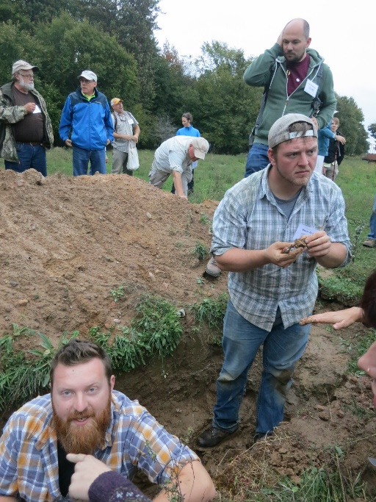
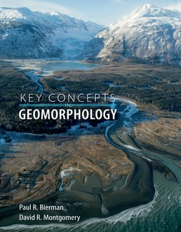
Geomorphology

Slide 3
GEOMORPHOLOGY
Simply defined ➔ the study of landforms
More complete definition ➔ the study of landforms and landscapes, the processes that produce them, and how they evolve (change) through time

Slide 4
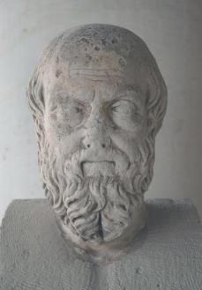
BRIEF HISTORY OF GEOMORPHIC THOUGHT
Herodotus (485–425 BC) “Father of History”
But also recognized for his geological observations
Annual flooding of the Nile River
Earthquakes due to Earth’s
“restlessness”

Slide 5
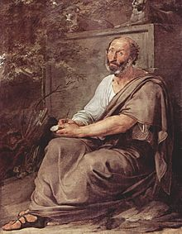
Aristotle (384 – 322 BC)
➔ Geologically known for his recognition that there were areas of land that were once covered by the sea
➔ He also noted the probability that land would reappear where the sea now exists

Slide 6
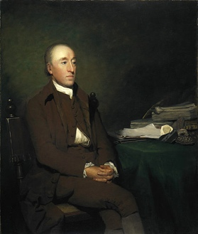
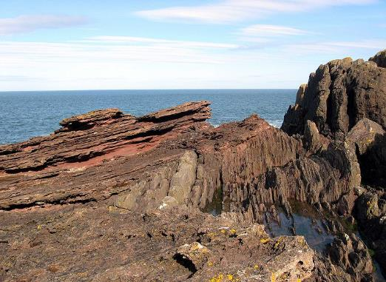
James Hutton (1726 – 1797)
Doctrine of Uniformitarianism – “the present is the key to the past”
1788 – Theory of the Earth with Proofs and Illustrations
Siccar Point

Slide 7
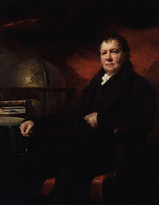
John Playfair (1748 – 1819)
John Playfair (1748 – 1819) younger colleague of Hutton
1802 – Illustrations of the Huttonian Theory of the Earth

Slide 8
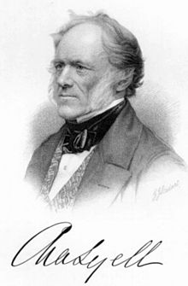
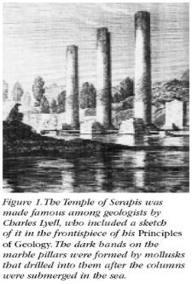
Sir Charles Lyell (1797 – 1875)
1830-1872 (12 editions) – Principles of Geology
Greatly influenced by Hutton, Playfair, and Darwin
Probably did more to advance geologic knowledge in general than any one person

Slide 9
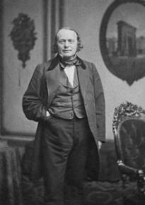
Louis Agassiz (1807 – 1873)
➔ 1840 – Study on Glaciers, Agassiz advanced the concept of an “Ice Age”
Several others anticipated his conclusions:
Bernhardi (Germany), Venetz and Charpentier ( Switzerland)
Agassiz later came to the U.S. and
convinced geologists like
T.C. Chamberlin and Frank Leverett
of the former presence of a large
ice sheet in North America

Slide 10
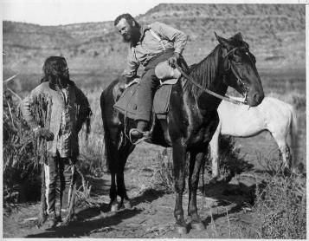
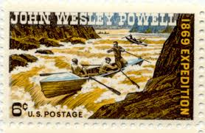
Developments in North America
1879 – establishment of USGS; surveys
of the Western U.S.
John Wesley Powell (1834 – 1902)
One of the early USGS Directors
Organized the Western U.S. surveys
First conquered the rapids of the Colorado River
Laid the foundation for the
American school of geomorphology
Developed the concept of
base level

Slide 11
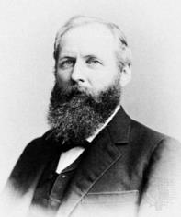
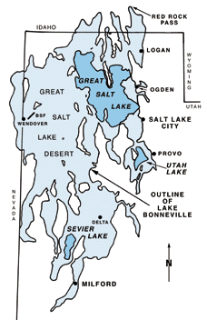
G. K. Gilbert (1843 – 1918) often called the father of modern American geomorphology
➔Senior Geologist with USGS 1879-1918
➔Mapped and interpreted the history of
Pleistocene Lake Bonneville
➔Interpreted fault-block origin of
the Basin & Range province
➔Wrote report on geology of the
Henry Mtns. of Utah (laccolith)
➔conducted flume experiments

Slide 12
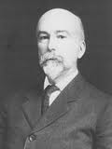
William Morris Davis (1850 – 1934)
Developed the concept of the Geomorphic Cycle (Cycle of Erosion)
This idea holds that in the evolution of Landscapes there is a systematic sequence of landforms that makes possible the recognition of stages of development

Slide 13
Fluvial Geomorphology
Drainage Basins
Geomorphic Hydrology
Channel development

Slide 15
Fluvial Geomorphology
Critically important to understanding
Landscape evolution
Human landscape connectivity
Regional (tectonic and climatic) vs. Local controls (discharge, Vegetation, sediment type/load)

Slide 16
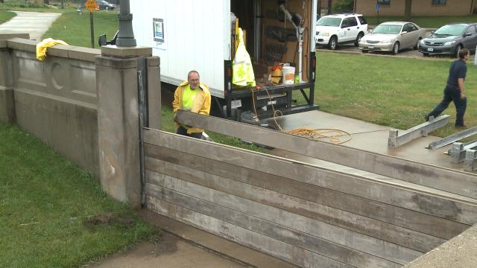
Anthropogenic vs. Natural change

Slide 17
Rural to Urban connections

Slide 18
Floods

Slide 19
Holocene Vs. ‘Anthropocene’ Epochs

Slide 20
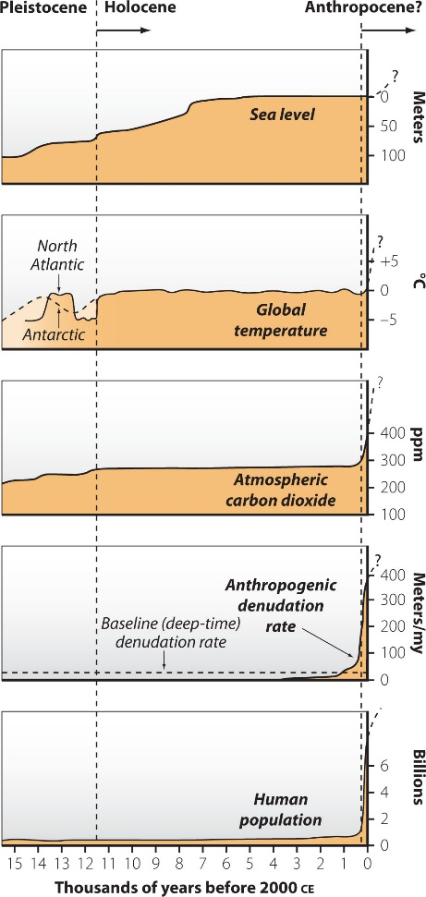

Slide 21
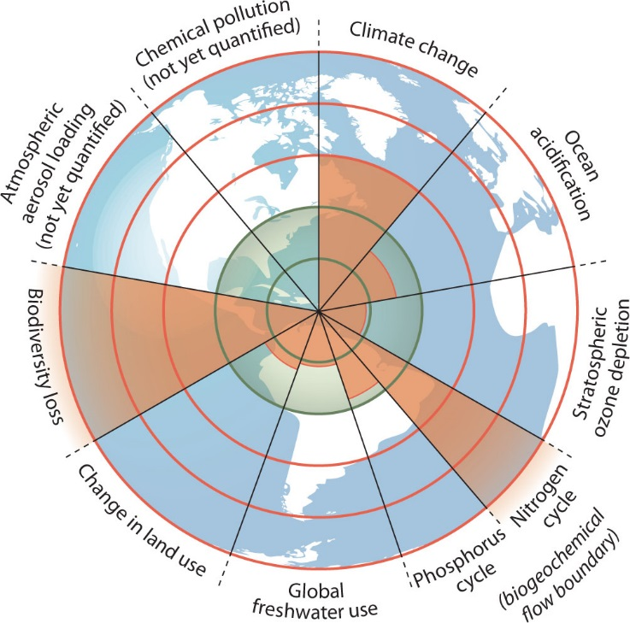
Ruddiman, 2008, QSR
Rockstrom, 2009, Nature

Slide 22
Global Sedimentary Transport
Rivers 85 to 90%
Glaciers 7%
Groundwater and Waves 1 to 2 %
Wind and Volcano less than 1%

Slide 23
NOAA

Slide 25
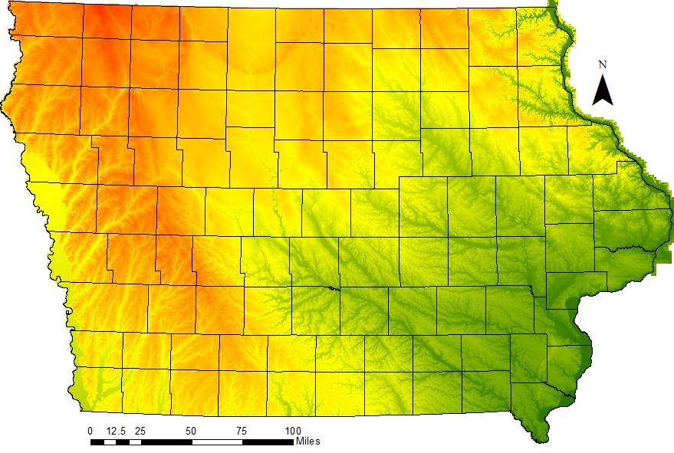

Slide 26
Drainage patterns
Common in Iowa
Dendritic

Slide 27
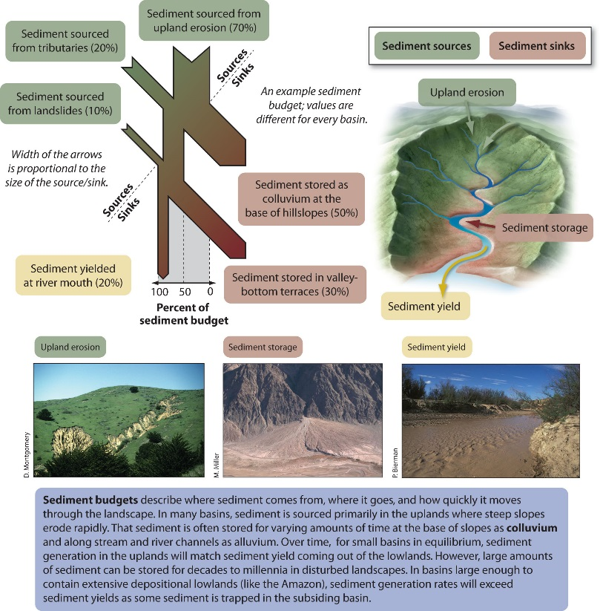

Slide 28
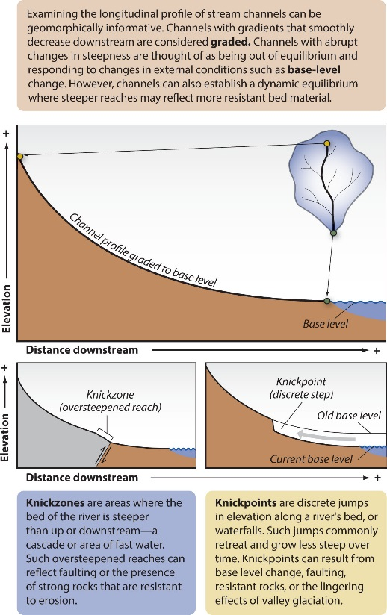
Grade and Base level

Slide 29
The concept of Grade in fluvial systems.
Grade
A tendency for fluvial channels to exhibit long-term self regulation.
A sort of equilibrium in which an open system through which mater and energy flow ( a river) achieves relative stability.

Slide 32
River Variables – Complex/Dynamic Systems
1. Stream velocity (m/s) or (ft/s)
2. Discharge (m³/s) or (ft³/s)
3. Gradient
4. Channel size and shape
5. Sediment load
6. Geologic environment
7. Vegetation
8. Anthropogenic modification
9 Hydrologic system/climate
ENERGY

Slide 33
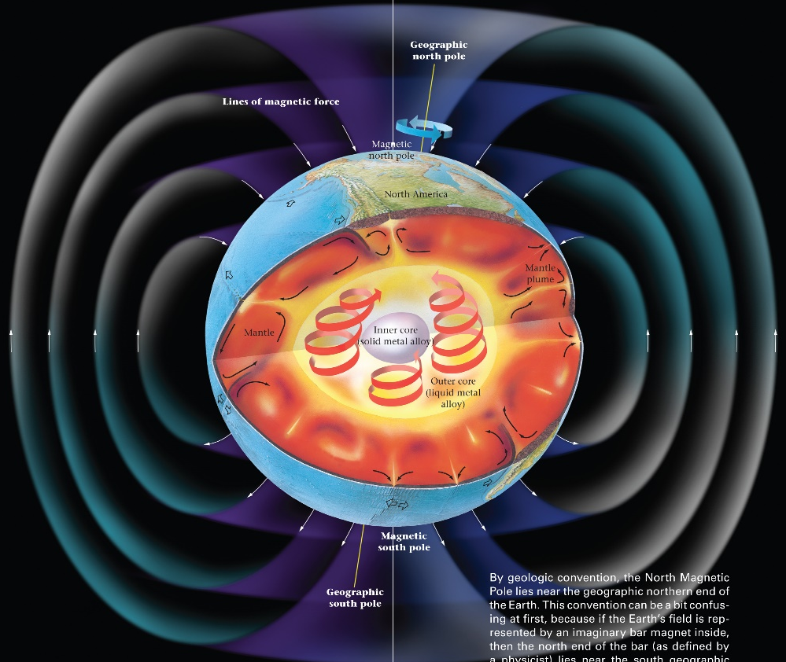
Energy

Slide 34
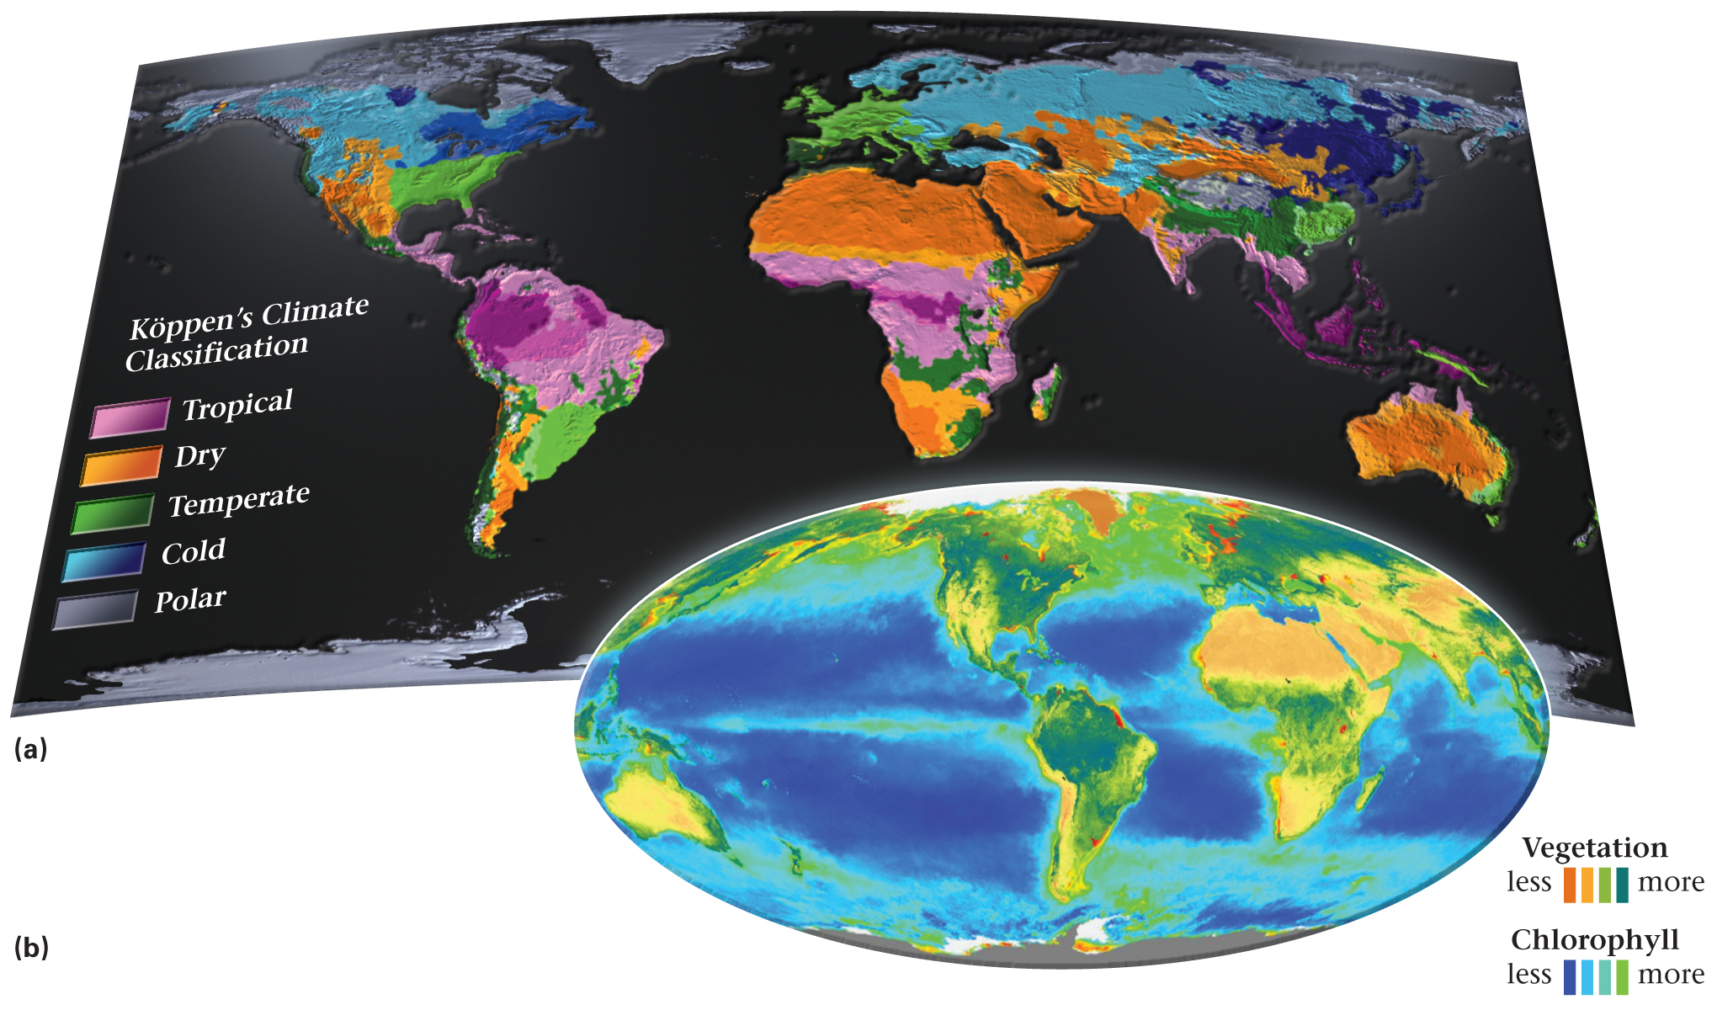

Slide 35
Energy to the Fluvial System
The conversion of potential energy (solar distillation and gravity) to kinetic energy and heat powers the fluvial system.
Most of this energy is lost to turbulent flow.
Only 2 to 4 % of the potential energy of water moving downhill is converted to mechanical (erosion) work and transportation.

Slide 36
Variable Energy Processes Change Products/landforms

Slide 37
Energy considerations
Fluvial intensity varies among
climatic regions
along temperature gradients
precipitation types and volumes
altitude
vegetated zones
seasonal change
Human altered landscapes
1/3 of the Earth’s land surface does NOT have run-off to the oceans.

Slide 38
Energy cont.
Concept 1. The same physical processes and laws that operate today have operated throughout geologic time, although not necessarily always with the same intensity as now. (Uniformitarianism)
Concept 2. Geologic structures are a dominant controlling factor/variable in the evolution of landforms and they are reflected in them.
Concept 3. To a large degree the Earth’s surface relief is a product of geomorphic processes operating at differential rates.

Slide 39
Conservation of Mass
I – O = ∆ST
I = Input
O = Output
ST = Storage

Slide 40
Conservation of Energy
Energy is neither created or destroyed, only transferred…
Potential energy
- Matter at rest
Kinetic energy
- Matter in motion

Slide 41
Material routing
Geomorphic systems route/move material from eroding sources to depositional sinks.
Weathering Erosion Transportation
Deposition = Landscape evolution & dynamics

Slide 42
Force balances
Normal stress
ρ g z cosθ
Shear stress
ρ g z sinθ
ρ = density of matter
g = gravitational acceleration
z = thickness
θ = angle of slope

Slide 44
Geomorphic thresholds
Physical, Chemical and or Biological conditions that when reached or exceeded trigger a CHANGE in state or shift t a new range of average conditions.

Slide 45
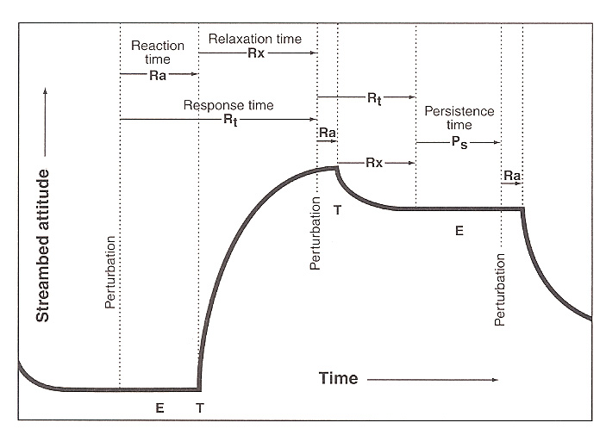

Slide 47
Flowing water

Slide 48
Vocabulary
Permanent (year round discharge)
Intermittent (seasonal discharge)
Ephemeral (only during and after rainfall)
Influent – (Arid/dry – loss of surficial water – low water table)
Effluent (Humid/moist – gain in Surficial water – High water table)

Slide 49
Fluvial Erosion and Transport
Sediment load
Dissolved load
Suspended load
Bed loads
Rolling
Sliding
Saltation

Slide 52
Fluvial Competence
The measure of a river’s ability to transport a particular maximum particle size.
Competence is a function of:
Flow velocity
Channel shape
Amount of suspended load
Particle shape
Degree of sorting
Water temperature

Slide 53
River Capacity
Theoretical maximum amount or mass of sediment that a river can transport.
1. Dissolved load has no effect on the hydrologic flow of rivers
2. Bed load is virtually impossible to measure

Slide 54
Suspended load
Is measured and determines capacity.
Suspended load source
Capacity
Discharge

Slide 56
Flow Velocity / Manning’s Equation
U = (R^{2/3} S^{1/2} )/n
U = Stream flow velocity
R = Hydraulic Radius ((cross sectional area ( A_{cs} ) / Wetted perimeter ( P_{w} ))
S = Water surface slope
N = Manning roughness coefficient

Slide 58
Froude Number / Flow Turbulence
Fr = u/(dg)^{0.5}
U = Flow velocity
D = Flow Depth
G = gravitational acceleration
Tranquil / Subcritical flow
Fr < 1
Critical Flow
Fr = 1
Supercritical flow
Fr > 1

Slide 59
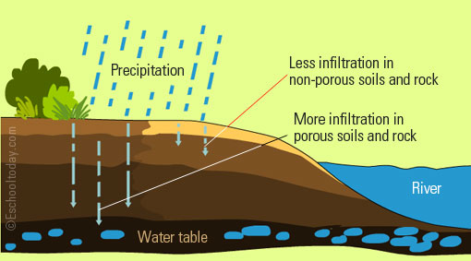
Primary Overland Flow Types
Infiltration
Through (Interflow)
Sheet flow
Channelized

Slide 60
Infiltration considerations
Intense rainfall may exceed the capacity of soil to intake water, creating overland flow.
An important factor that occurs in saturated through flow and NOT in overland flow is: Saturation adds seepage pressure increasing the probability of loose particles being transported down slope.

Slide 61
Through flow (Interflow)
Rapidly flowing groundwater moving down gradient within a soil catena’s interconnected cracks, burrows, root channels and soil voids with or without C or R-horizon saturation.

Slide 63
Effluent
Influent

Slide 64
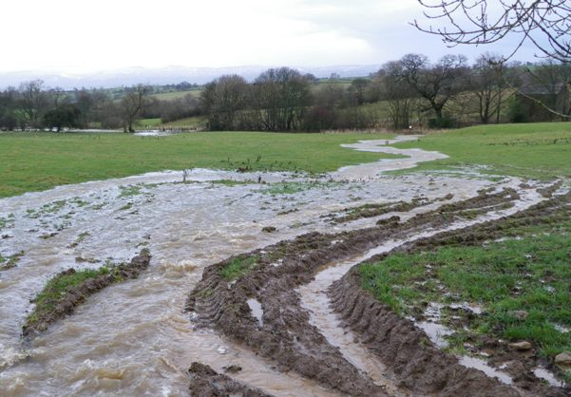
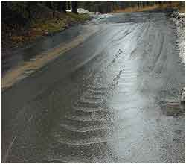
Sheet flow
Occurs on bare low gradient surfaces, that have a scattering effect
suppresses impact energy and channel formation.
Muddy water flows as a thin, slow moving surface layer.

Slide 65
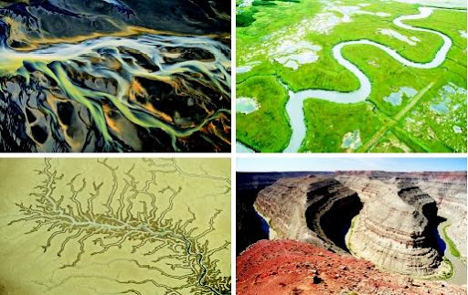
Channel Development
Piping and Sapping
Rills
Gulleys

Slide 66
Rill and Gully Formation
A critical point is reached once the landscape threshold is reached and erosion is initiated.
Piping is a function of seepage pressure in soil that aggressively undermines small pits or rill heads where seepage pressure is the greatest. Start of headward propagation.

Slide 67
Rills
Threads of higher velocity and more turbulent current eroded small channels.

Slide 68
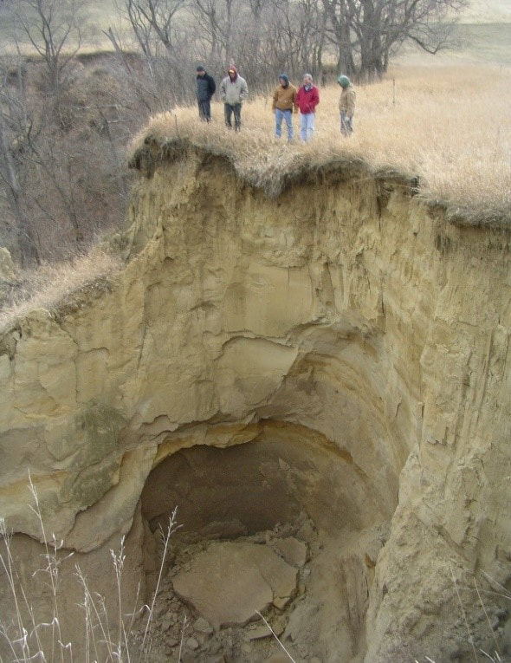
Gully
A stream channel with distinct cut banks and commonly a steep head.
agricultural practices.
John Thomas – Hungry Canyons Alliance
http://www.goldenhillsrcd.org/hungry-canyons-alliance.html

Slide 69
Sediment supply / Bank Stability

Slide 71
Channel Types

Slide 75
Primary sediment – fine/silt

Slide 77
Primary Sediment – Course/gravel

Slide 80
Vegetation/Riparian System

Slide 84
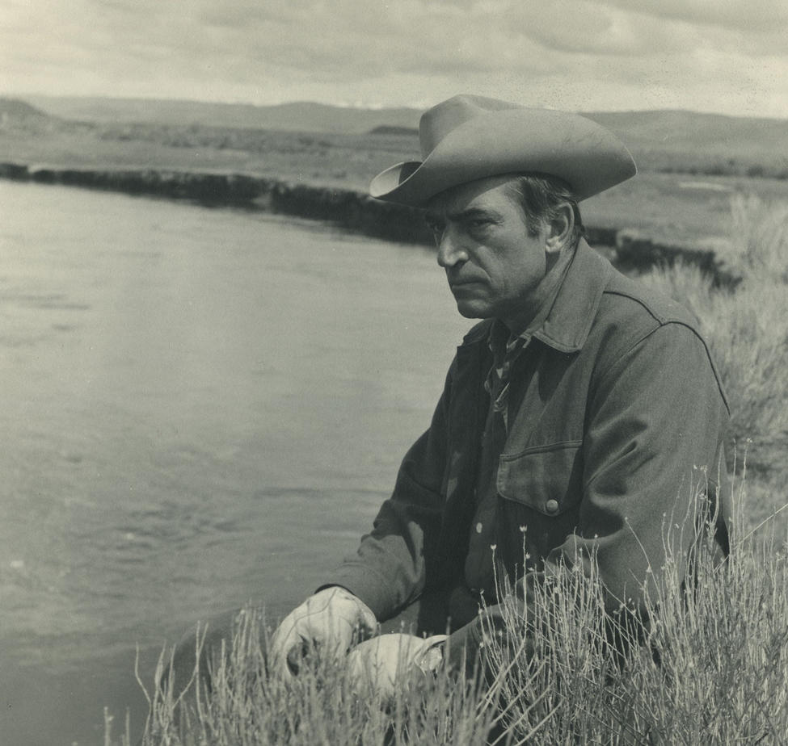
Luna Leopold
“A river or drainage basin might be considered to have a heritage, rather than an origin.”
First Chief Hydrologist at the USGS
http://eps.berkeley.edu/people/lunaleopold/
https://www.usgs.gov/news/lessons-learned-legend-luna-leopolds-view-river

Slide 85
Hydrographs
Provides an important visual reflection of precipitation in a given watershed.
(A fingerprint if you will)

Slide 86
The Water Year
October 1st to September 30th
Based on recharge time.

Slide 87
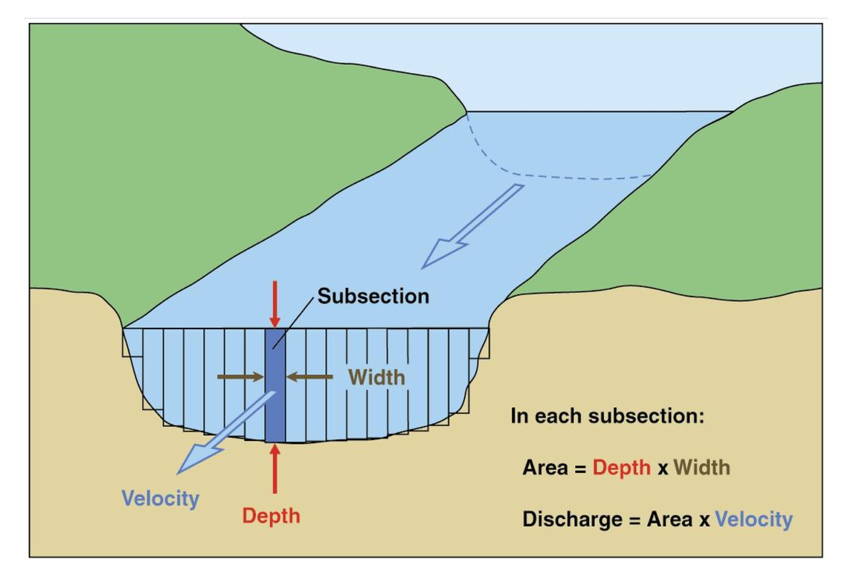
Discharge
Q = Avg. W*Avg. D*Avg. V

Slide 88
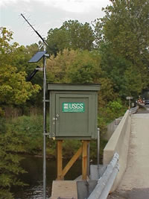
Stream Flow Measurement
Gauging stations
Distributed in rivers throughout the world
Monitor stream discharge, water surface level, and the amount of suspended sediment
Continuously or periodically
Discharge = (Water Velocity * Channel Area)

Slide 89
https://waterdata.usgs.gov/ia/nwis/rt
CF = https://waterdata.usgs.gov/ia/nwis/uv?site_no=05464000

Slide 90
Iowa Flood Information System

Slide 91
Rating curves
Once the discharge is determined for a variety of rainfall events, a rating curve may be produced.
Then
Discharge may be determined by simply measuring the water surface

Slide 92
Hydrographs
Plot Discharge vs. Time
By connecting the two low points on a hydrograph it is possible to separate baseflow (groundwater) and storm surge from a rainfall event.
Helpful in determining flood crests as well as contaminate plum migration

Slide 93
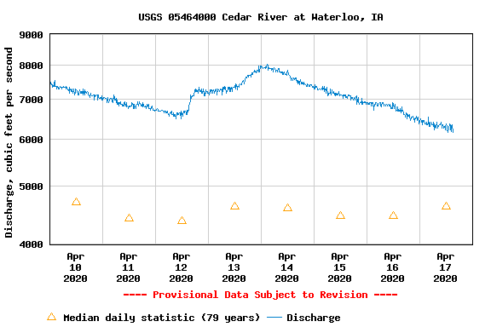

Slide 94
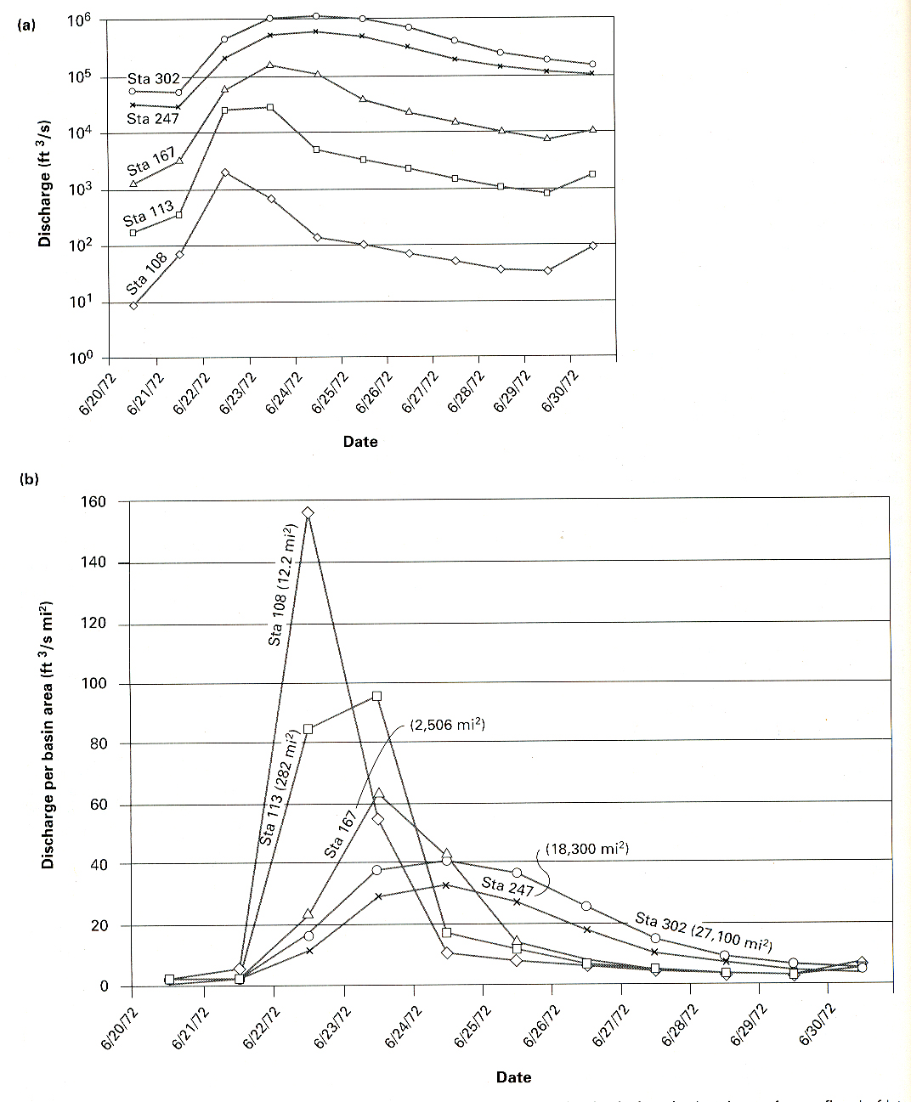
Hydrographs
Low-ordered streams will appear ‘flashy’
High-ordered stream will appear ‘gradual’

Slide 95
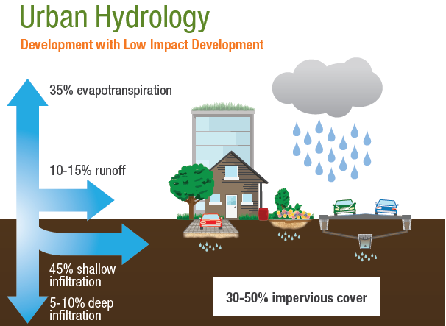
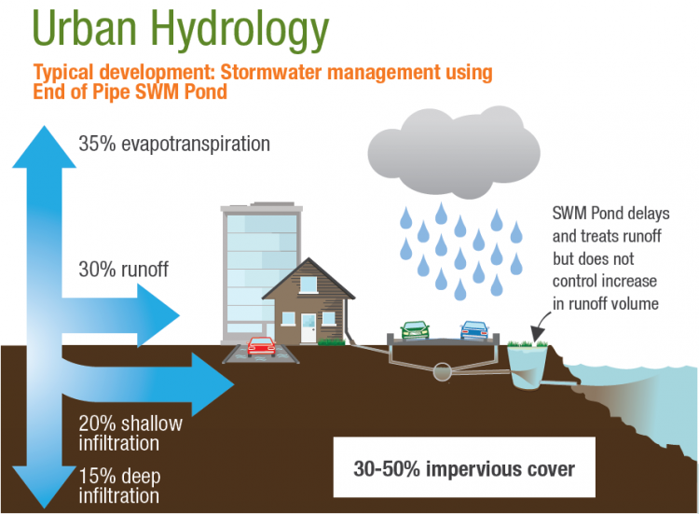
https://wiki.sustainabletechnologies.ca/wiki/Urbanization

Slide 96
River Restoration – Iowa DNR
https://www.iowadnr.gov/Environmental-Protection/Water-Quality/River-Restoration/River-Restoration-Toolbox

