Slide 1
Iowa’s Bedrock
Geological Resources of Iowa
University of Northern Iowa &
The Iowa Limestone Producers Association

Slide 3
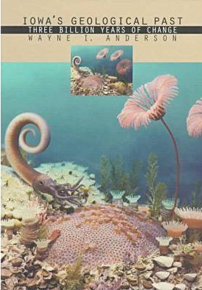
Geologic Time
Wayne Anderson
Jim Walters
Ray Anderson
Brian Glenister

Slide 4
Precambrian
4 Billion years
Paleozoic
545-245 Ma
Mesozoic
245-65 Ma
Cenozoic
65-2Ma
Pleistocene
2Ma-11,200
3 hours

Slide 5
The Holocene
About the past 11,200 years
North America was populated
Civilizations have come and gone
Volcanoes have erupted
Glaciers have melted
Atmospheric Carbon dioxide has skyrocketed
The Cubs won 2 World Series…
About 1.1 minutes

Slide 6
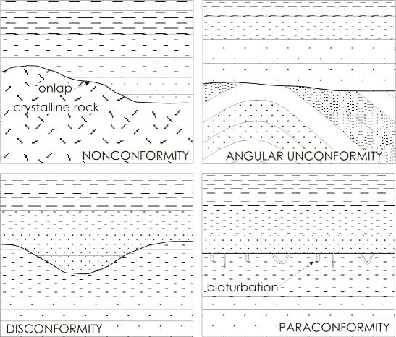
Unconformities (Gaps in time, ‘missing pages’)
A. Geologic strata never formed OR deposited
B. Geologic strata were formed and/or deposited, but were partially or completed eroded

Slide 7
Major Unconformities in Iowa
Base of Cambrian
Within Ordovician
Base of Devonian
Between the Mississippian and Pennsylvanian
Between the Jurassic and Cretaceous
Iowa does not have any exposed rocks dating to the Permian or Triassic

Slide 8
Origin of Geologic Time Names
Use of tribal names
Ordovician – Ordovices (historic Welsh tribe that was the last to submit to the Romans.
Silurian – Silures (ancient Wales tribe)
Geographic localities
Cambrian – Cambria (Roman name for Wales)
Devonian – Region of Devonshire England

Slide 9
What do we use to interpret Iowa Geologic History?

Slide 10
Precambrian – The Oldest Rocks
541 Ma
to
4.6 Ga
Iowa’s geologic history began approx. 3Ga ago with igneous and metamorphic rocks.
Followed by mountain building events: Penokean, Central Plains, and Eastern Granite-Ryholite Province ‘orogenies’ a product of plate tectonics.
Iowa’s oldest exposed rock is the Sioux Quartzite (approx. 1.6 Ga)
1.1Ga North America and Iowa were nearly torn apart by the Mid-continent Rift System

Slide 11
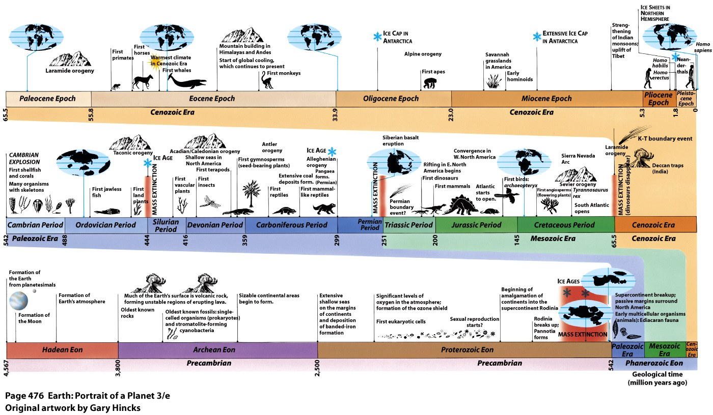

Slide 12
Extended concept (Igneous Intrusive vs Extrusive rocks)

Slide 14
Regional Basement Structure
Oldest rock = Minnesota tarrane 3.6Ga, Penokean Volcanic belt 1.8Ga, the Granite provenances in the south approx. 1.4Ga
Black Hills Granite (famously represented by Mount Rushmore) via a Tertiary uplift/orogeny

Slide 15
Iowa’s Igneous & Metamorphic ‘Basement’
Gravity surveys supplement direct observations (samples)
(+) anomalies indicate dense rock bodies i.e. basalt and gabbro
(-) anomalies indicate low density rocks i.e. sandstone and shale
+
-
-
+
-
-
-
+
-
-
+
-
+

Slide 16
The Eischeid Well – Iowa’s Deepest Drilled Well
Upper ‘Red-Clastic’
Carroll County
Amaco Production Company
208 days of drilling to reach a depth of 17,851ft (one of the deepest in the Midwest!)
$20,000,000.00
Lower ‘Red-clastic’

Slide 17
Duluth Complex & North shore Lake Superior

Slide 18
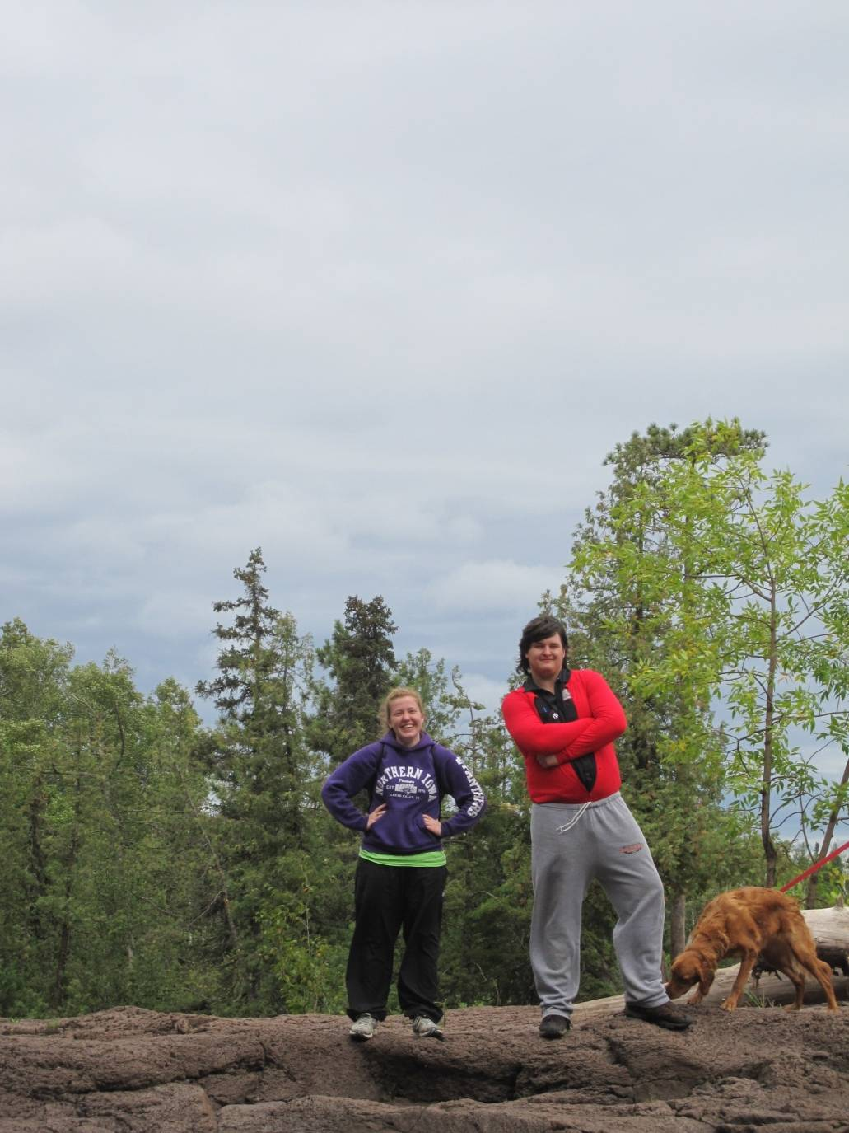

Slide 19
BIF
2.2 Ga
to
2.4 Ga

Slide 20
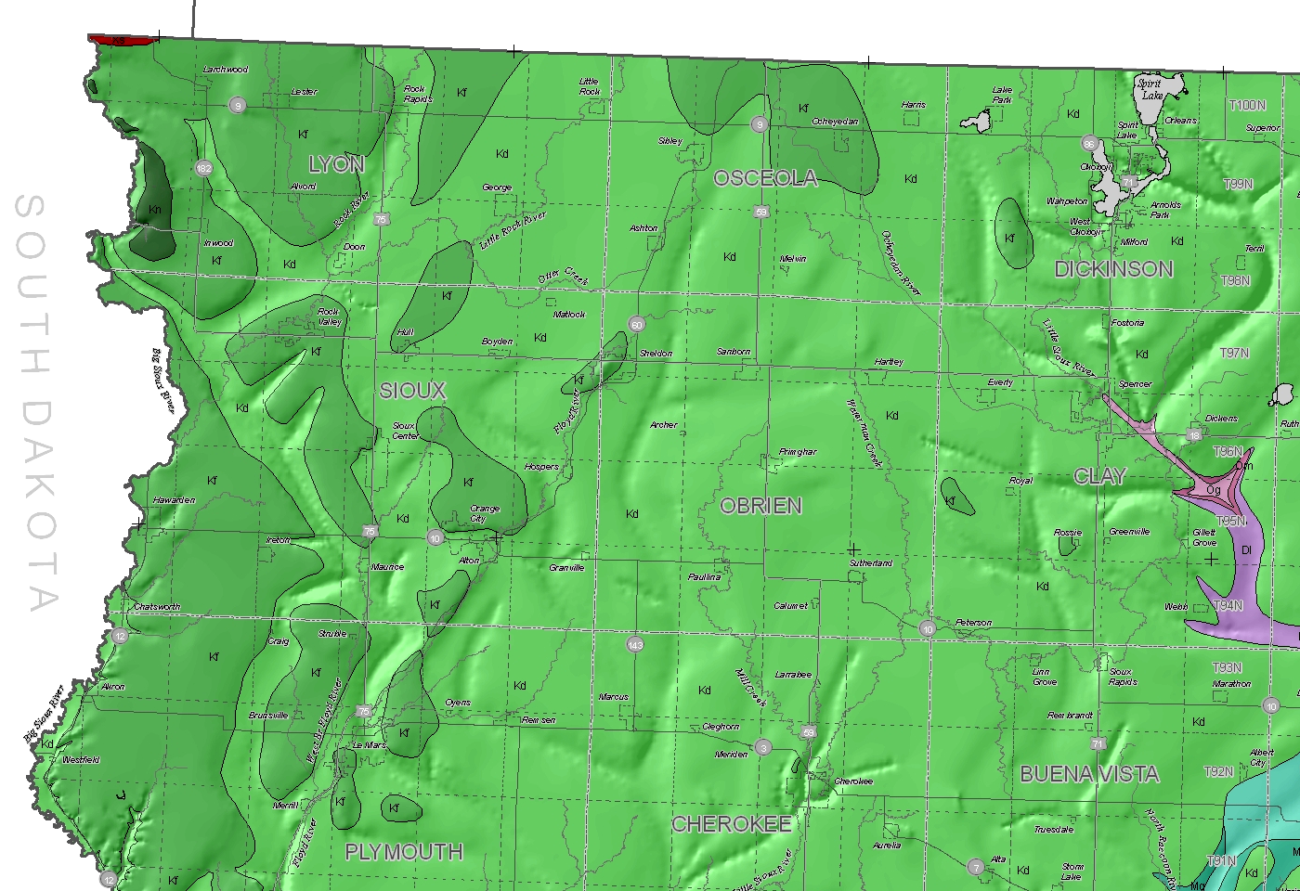
Sioux Quartzite (1,600 ma)
Ray Anderson

Slide 21
Sioux Quartzite
Gitchi Manitou State Preserve
1969
The rock is still quarried near Sioux Falls, SD
Was mistaking called Sioux Granite
NOT part of an uplift rather the Sioux Ridge is likely a product of differential weathering

Slide 22
Sioux Quartzite
Environment of Deposition?
Upper portion = tidal/shallow marine
Lower portion = fluvial/river
The formation is up to 7,800ft thick
Correlated with the Baraboo Quartzite
Occurs in eastern at great depths
Federal building in Sioux Falls, SD

Slide 23
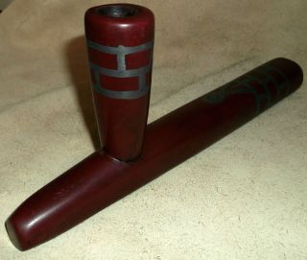
Pipestone
Pipestone National Monument, MN
Adjacent red to pink mudstones
Catlinite (after George Catlin, 1800s)
Prized by Native Amercians and traded throughout the Great Plains and Colombia River Basin

Slide 24
Iowa’s Paleozoic

Slide 25
Concept – Transgressive vs. Regressive Seas

Slide 26
Cambrian – Sandy Marine Shelves & Shorelines
485 Ma
to
541 Ma
The Cambrian is generally know as a periods for the Explosion of Life and for a dramatic increase in available/atmospheric O2
The early to mid-Cambrian saw massive periods of weathering/erosion and as a product there is a large unconformity until the late Cambrian in Iowa
During the Late Cambrian, shallow seas encroached upon Iowa and reworked the eroded (Precambiran & Early Cambrian) sediments including resistant quartz, feldspar, clay minerals, and trace amounts of zircon, tourmaline and garnet.

Slide 28
Late Cambrian Sandstone
Throughout the Midwest there are numerous sandstone formations that are mature:
Physically
Well rounded
Well sorted
Chemically
Mostly quartz
Some areas rich in feldspar too

Slide 29
Concept of Geologic Formations
A body/layer of rock that consists dominantly of a certain lithologic rock type
Maybe combined into Groups
Or maybe divided into Members

Slide 30
Stratigraphy – The science of rock layers
Concerned with all characters and properties (physical, chemical and/or biological)
Enables geologists to trace rock formations from one place to another
Helps geologists to interpret modes of origin and history

Slide 31
Correlation

Slide 32
Relative dating - Law of Superposition

Slide 33
The Jordan Sandstone
Some layers are cemented with dolomite
Formed on a shallow marine shelf and shoreline
High porosity and moderate permeability
Serves as one of the Iowa’s best groundwater/aquifers

Slide 34
Location

Slide 35
Cambrian Life
The age of the Trilobites
Trilobites and brachiopods are abundant in this period, but not in Iowa.
Why???
Iowa’s Cambrian record is dominated by SANDY near shore transition environments.

Slide 36
Ordovician – Warm, Shallow Seas
443 Ma
to
485 Ma
Early Ordovician – Again on the edge of a shallow sea depositing carbonate, sandy carbonate, and quartz sandstones (Prairie du Chien Group) before another series of weathering and erosion!
Mid-Ordovician – Major sea transgression changed a sandy shallow sea to carbonate shelf. Ash layers appear in the Decorah and Dunleith Formations.
Late Ordovician – Increasingly muddy depositional environments forming the carbonate-rich shale layers (e.g. the Maquoketa Shale).
Towards the end of the Ordovician the seas regress and weathering and erosion begin again, creating an ???

Slide 38
Ordovician stratigraphy

Slide 39
St. Peter Formation
Quartz Sandstone (super mature)
But, In NW Iowa the St. Peter contains a lot of shale from the then exposed Transcontintal Arch
Well exposed in Pikes Peak St. Park
An important economic resources for glass and fracking
1960’s served as a fall out shelter with supplies to meet the needs of 44,000 residents for two weeks

Slide 40
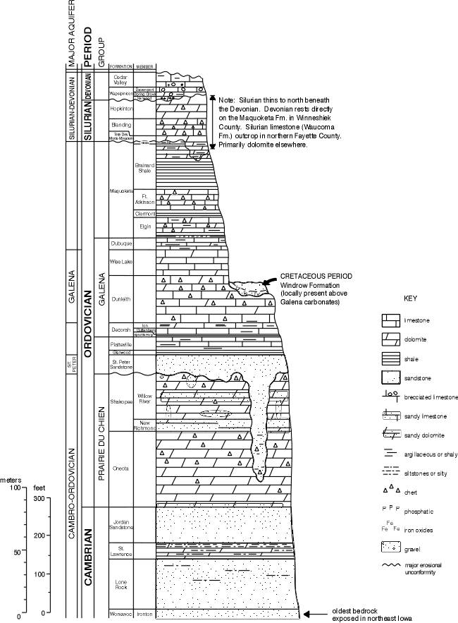
Galena Group
Dunleith, Wise Lake, and Dubuque Formations
Upper Mississippi Valley Zinc and Lead District

Slide 41
How does Galena & Zinc form in Limestone?
Space is created, through karst processes
Warm sulfide-rich solutions migrate upwards and infiltrate the new space
Sulfide minerals precipitate out of solution and along the edges of these new spaces
The Mississippi cuts its channel into the landscape and lowers the water table
Exposing the sulfide minerals, creating Iron sulfide, Lead sulfide, and Zinc sulfides
CO2
H2CO3
H2O
Warm Sulfide rich minerals

Slide 42
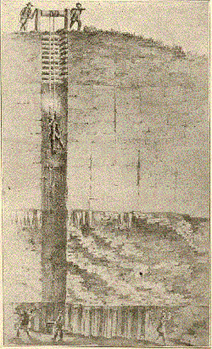
Lead and Zinc Mining 1788-1810
Spain ruled Iowa via the Treaty of Paris (1763) as a product of the French and Indian War (1756-1763)
Julien Dubuque became friends with the local Meskwaki, eventually marrying Potosa and entering their culture as Little Night.
Julien, identified the mineral recourses and with the Meskwaki’s permission began mining
Julien, requested ownership/confirmation of his land from the Spain, and it was granted in 1796. ‘The Mines of Spain’
Died at 45 (1810) deeply in debt

Slide 43
Maquoketa Formation
Thick impermeable shale
Large caverns were excavated under Johnson and Polk counties to seasonally store liquefied petroleum gas
Enables the pipeline industry to store their product so that they can meet demand during the winter

Slide 44
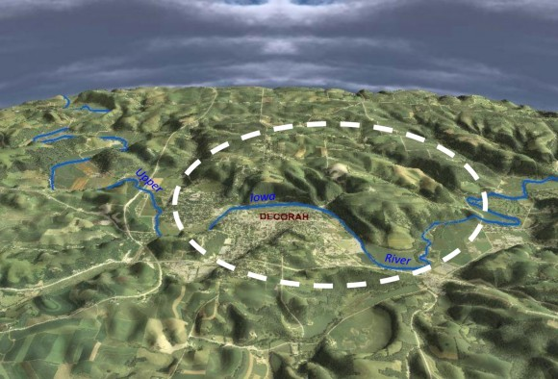
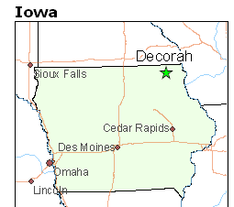
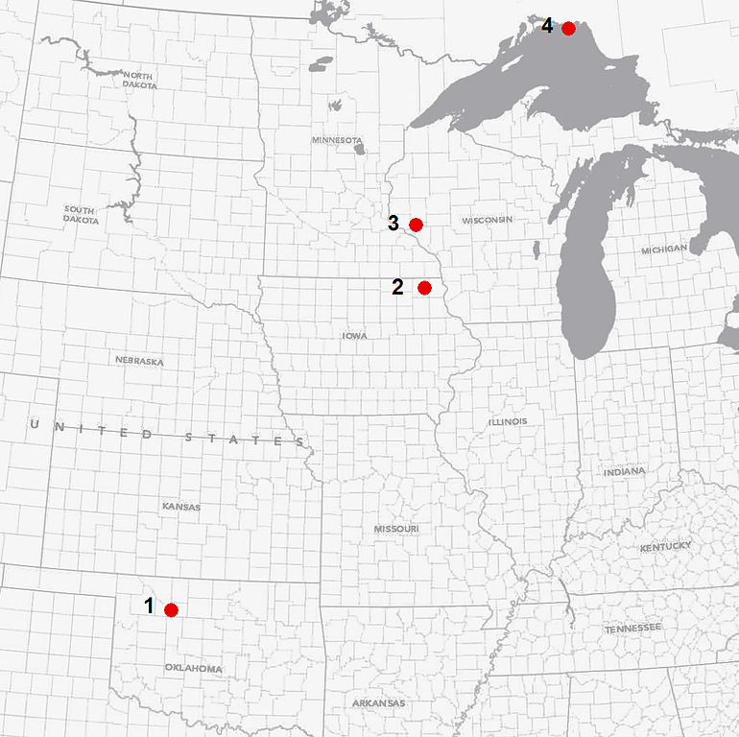
Decorah Structure

Slide 45
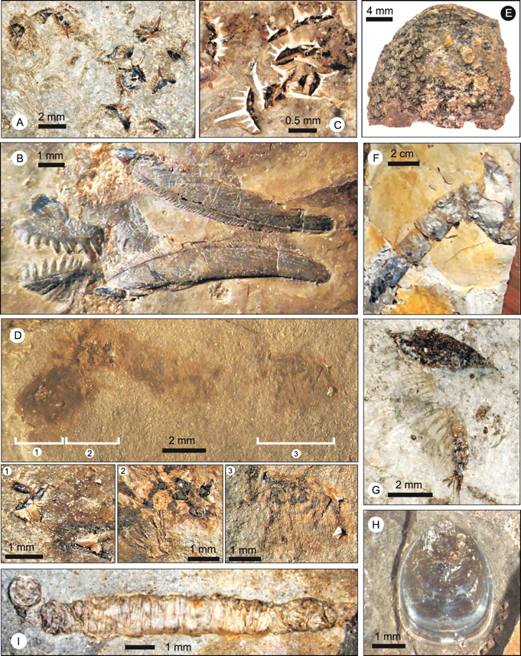
Ordovician Life: Warm shallow seas = ☺ Life
Brachiopods
Bryozoans
Corals
Receptaculitides
Mullusks
Worms
Arthropods
Echinoderms
Graptolities
Conodonts

Slide 46
Process of Dolomitization
CaCO3
Mg replaces some Ca
CaMg(CO3)2

Slide 47
Silurian – Dolomite and Carbonate Mounds
419 Ma
To
443 Ma
Six Dolomite and two limestone formations, that provide the foundation for many of Eastern Iowa’s State parks.
There are five marine Transgression to Regression phases recorded in Iowa’s Silurian Formations.
These Silurian rocks have great economic value (agricultural lime, road aggregate, aggregate for concrete, building stone and as bedrock aquifers.
Towards the end of the Silurian there was another period of weathering and erosion that created an unconformity between the Silurian and Devonian.

Slide 49
Silurian stratigraphy
Brian
Witzke
Dolostone formations
Mosalem
Tete des Morts
Blanding
Hopkinton
Scotch Grove
Gower
Limestone formations
Waucoma
Le Porte City

Slide 50
Hopkinton Formation
Common in eastern Iowa
Very-fine to coarsely crystalline dolostones with areas of nodular chert
Contains four members
Sweeney
Marcus
Farmers Creek
Picture Rock

Slide 51
State Parks
Maquaketa Caves State Park
Backbone State Park
Mississippi Palisades State Park
Picture Rock County Park (Jones Co.)

Slide 52
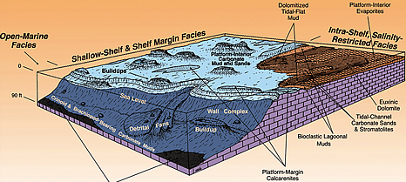
Scotch Grove Formation
Overlies the Hopkinton Fm. as dolostone with cherty intervals
Represented by the natural bridge feature at Maq. Caves State Park

Slide 53
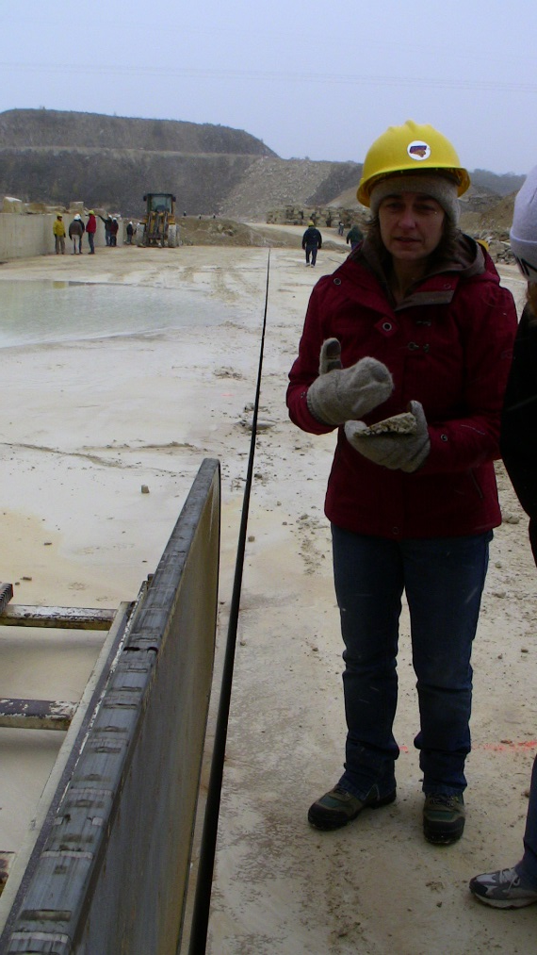
Anamosa Facies – Ideal building stone
Uniform bedding
Fine consistent texture
Used for many of Iowa’s early buildings
Rock Island Arsenal (IL)
Anamosa Prison
Stone City, IA
Cornell College
Herbert Hoover Presidential Lib.
Three large buildings in downtown Minneapolis

Slide 54
Silurian Life
Colonial corals
Favosites
Halysites
Solitary corals
Brachiopods
Algea

Slide 55
Applied paleontology

Slide 56
Devonian – A Marine Extravaganza ☺
358 Ma
To
419 Ma
The Devonian System contains 13 formations.
Economically valuable resource for road and concrete aggregate in eastern Iowa and gypsum is mined southeastern and north-central Iowa for Portland Cement.
The Devonian System also serves as an important aquifer/water source for eastern and north-central Iowa.
These formations also contain significant and well preserved fossils

Slide 58
Regional stratigraphy

Slide 59
Little Cedar Formation
Basal Fm. of the Cedar Valley Group
Solon Member is mostly limestone with abundant fossils
Rapid Member fine-grained argillaceous limestone that is also fossil rich

Slide 60
Lithograph City Formation
An extremely fine grained / pure limestone
Used for Lithography in the early 1900. Lithography City – Floyd-Mitchell county line
Quarried extensively for road and concrete aggregate as well as Portland Cement

Slide 61
Devonian Life

Slide 62
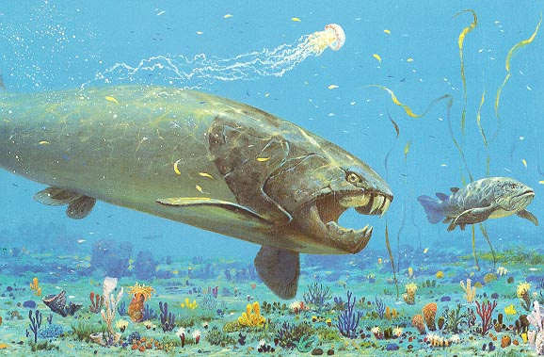
Devonian Life

Slide 63
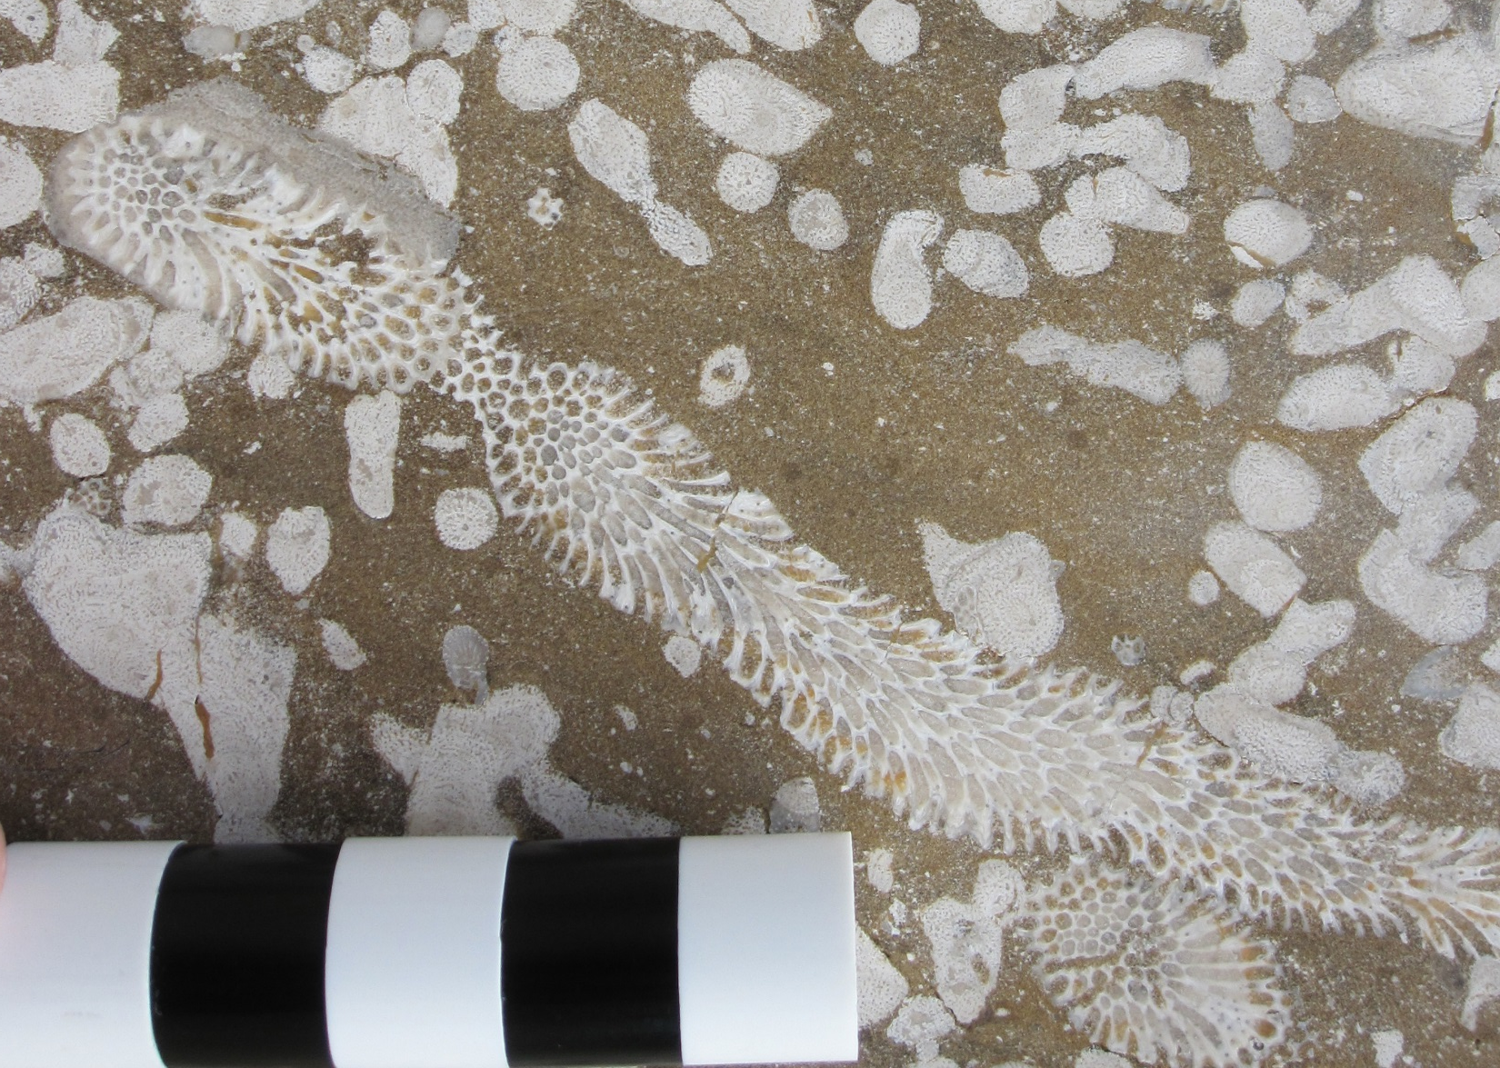
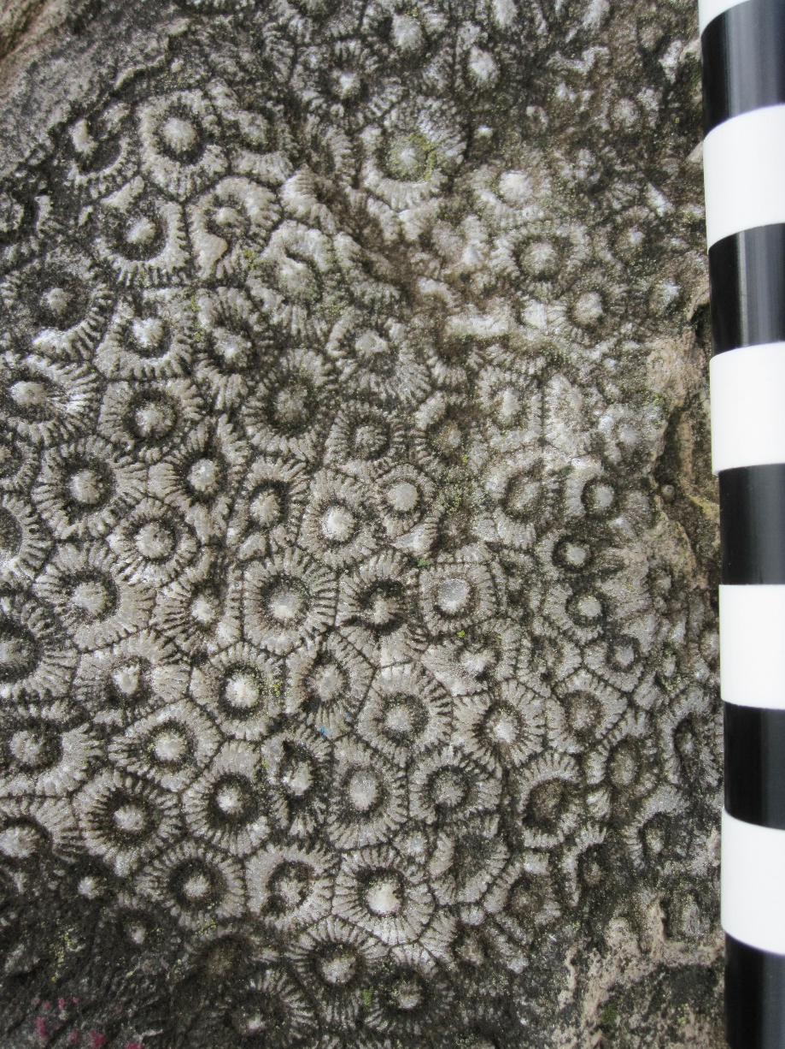
Devonian Life – Via the Devonian Fossil Gorge

Slide 64
Carboniferous – Mississippian – Last major sea
323 Ma
To
358 Ma

