Slide 1
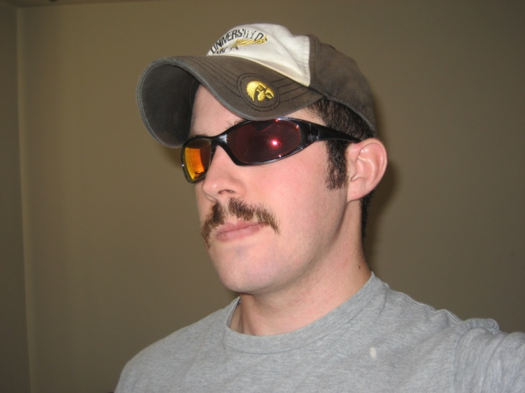
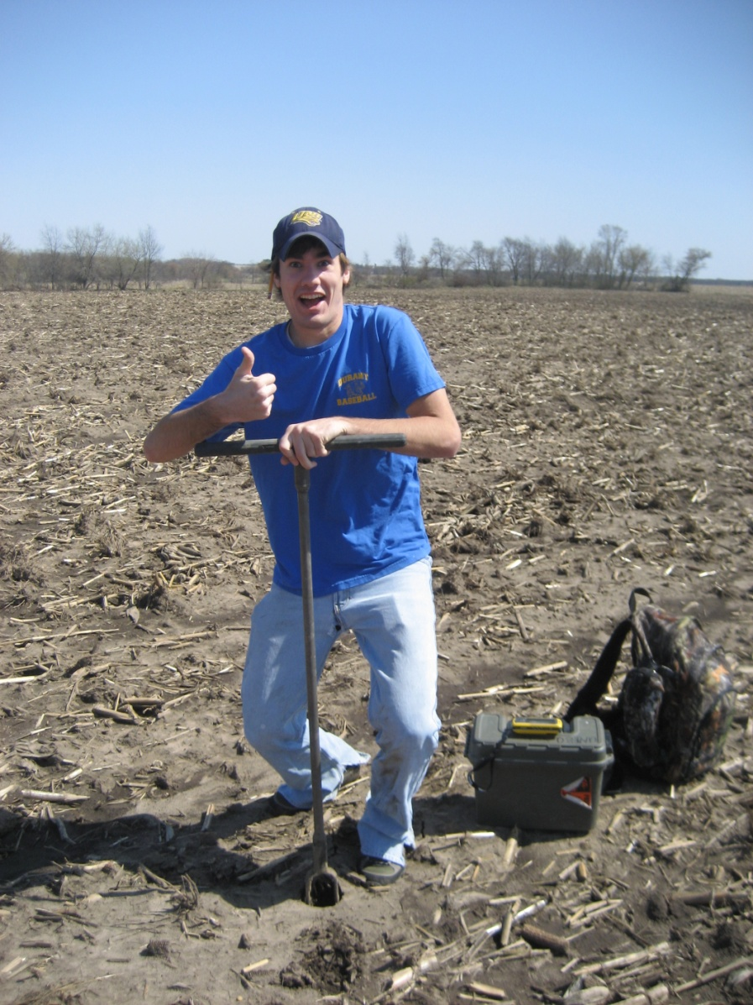
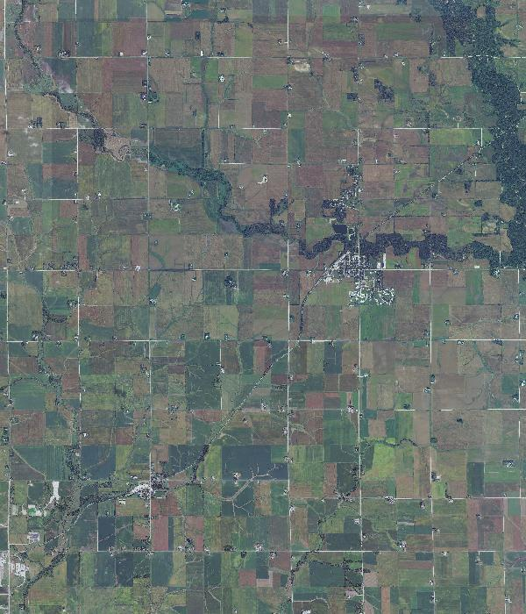

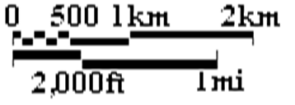
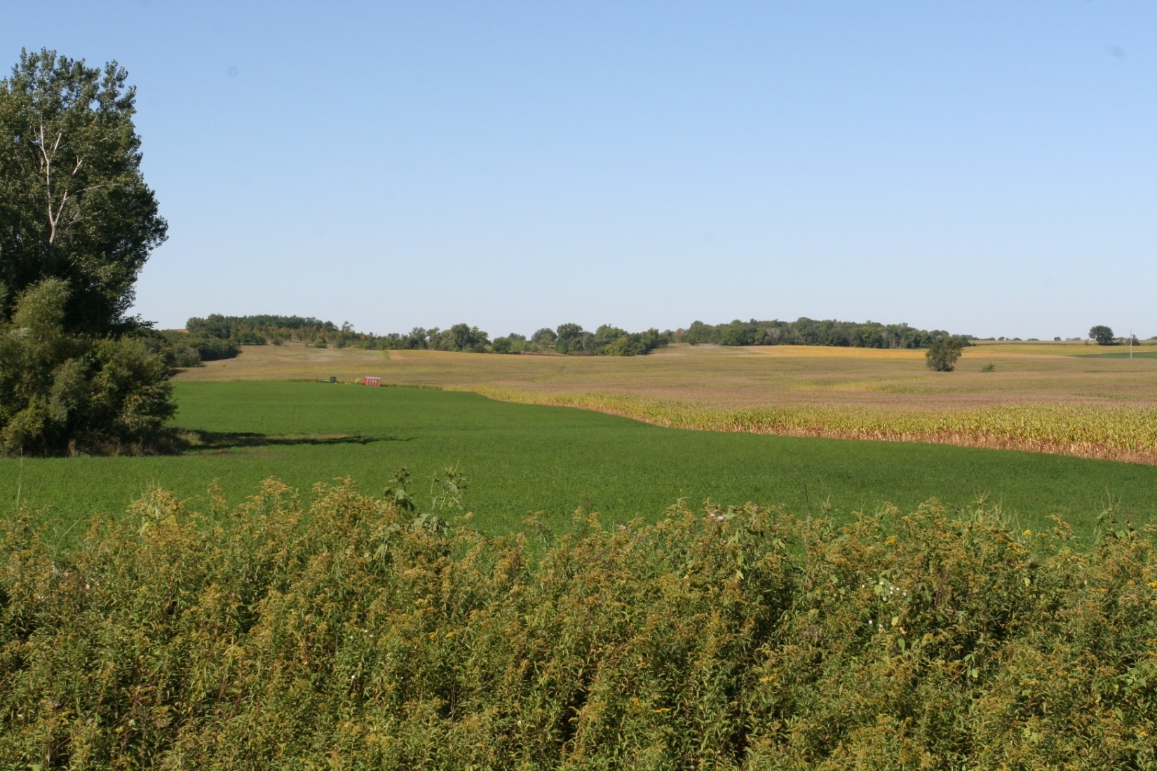
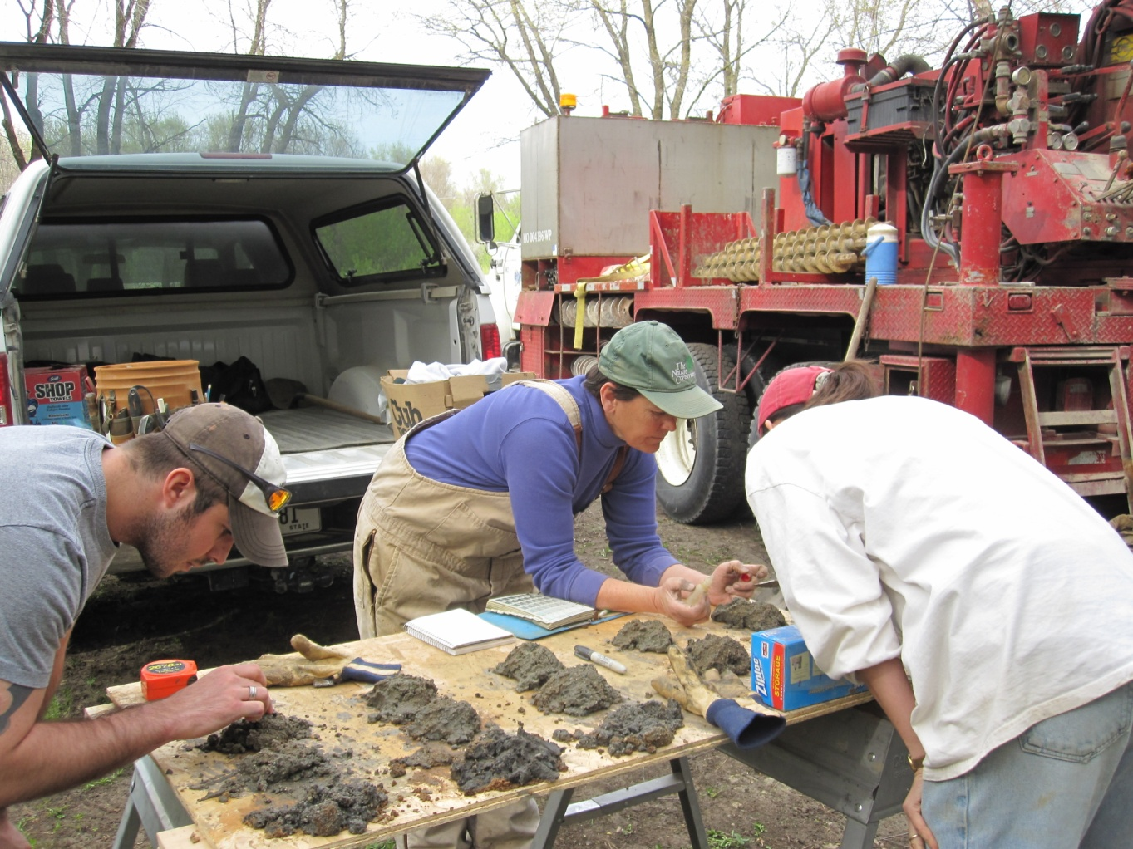
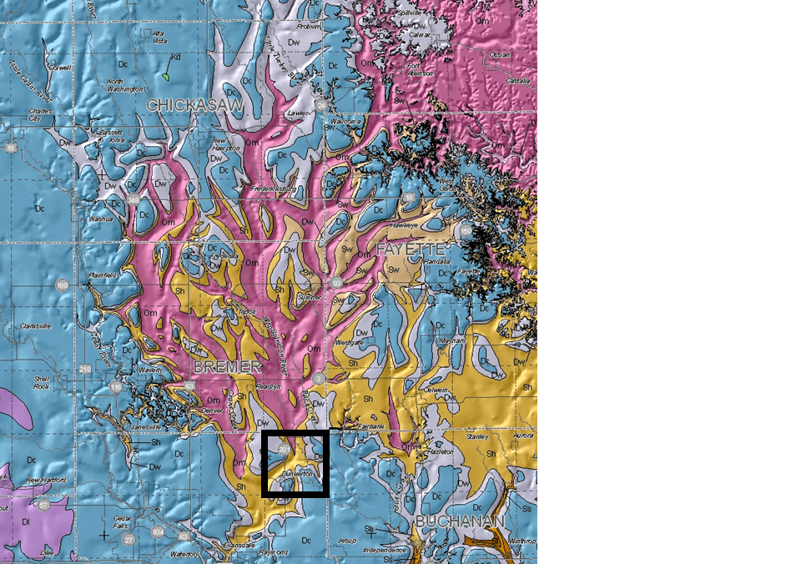
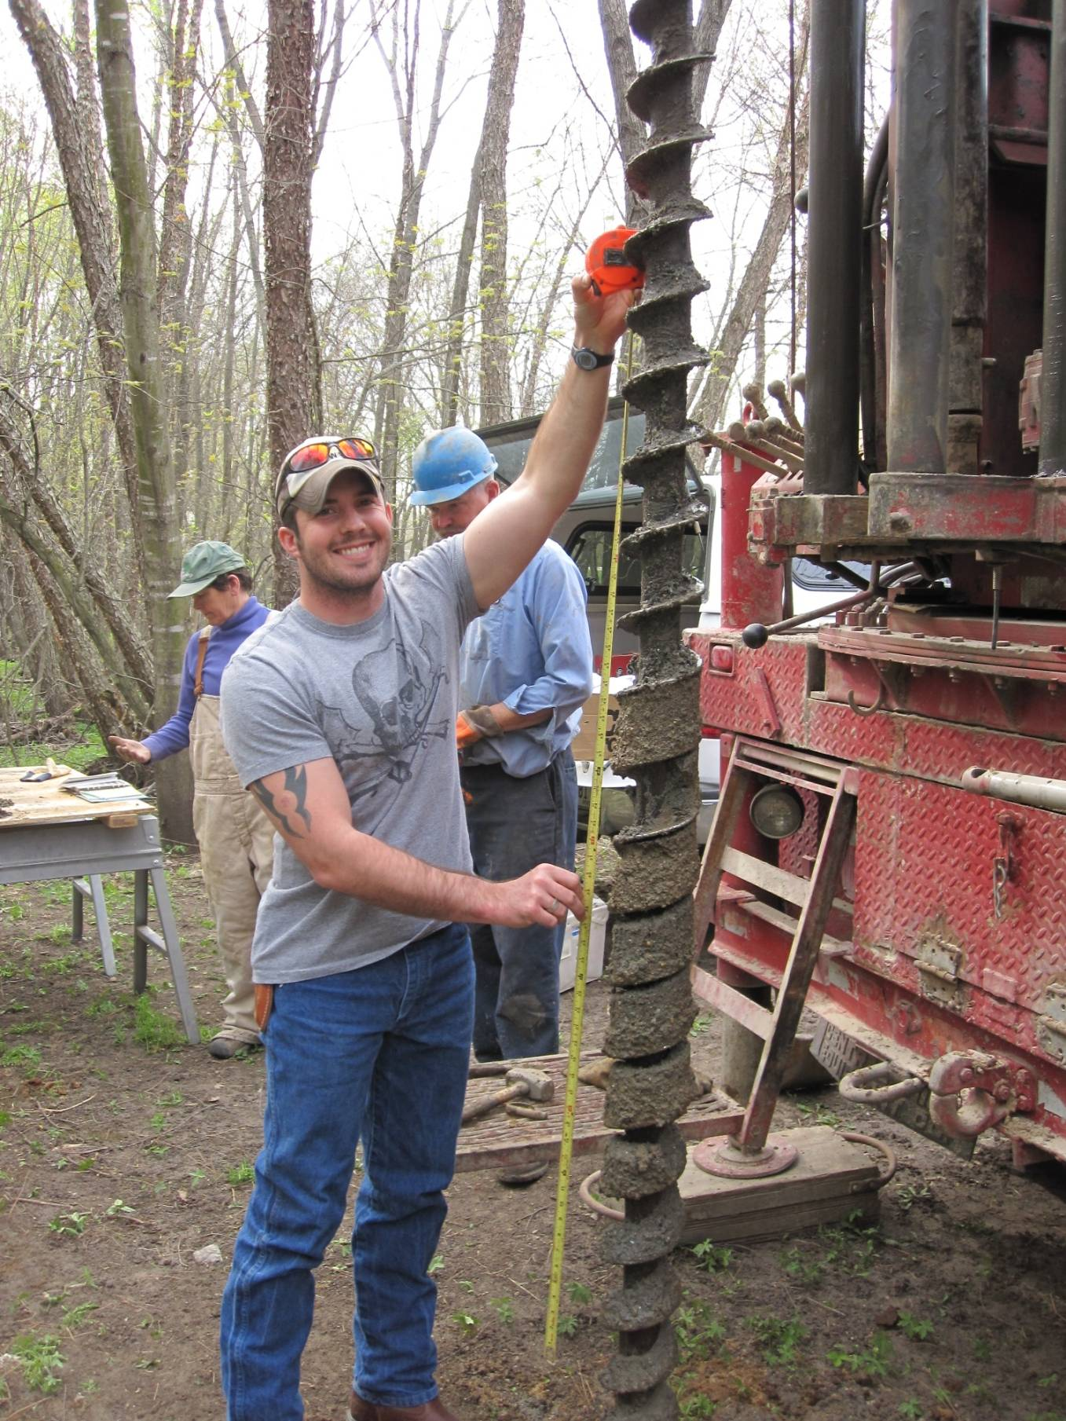
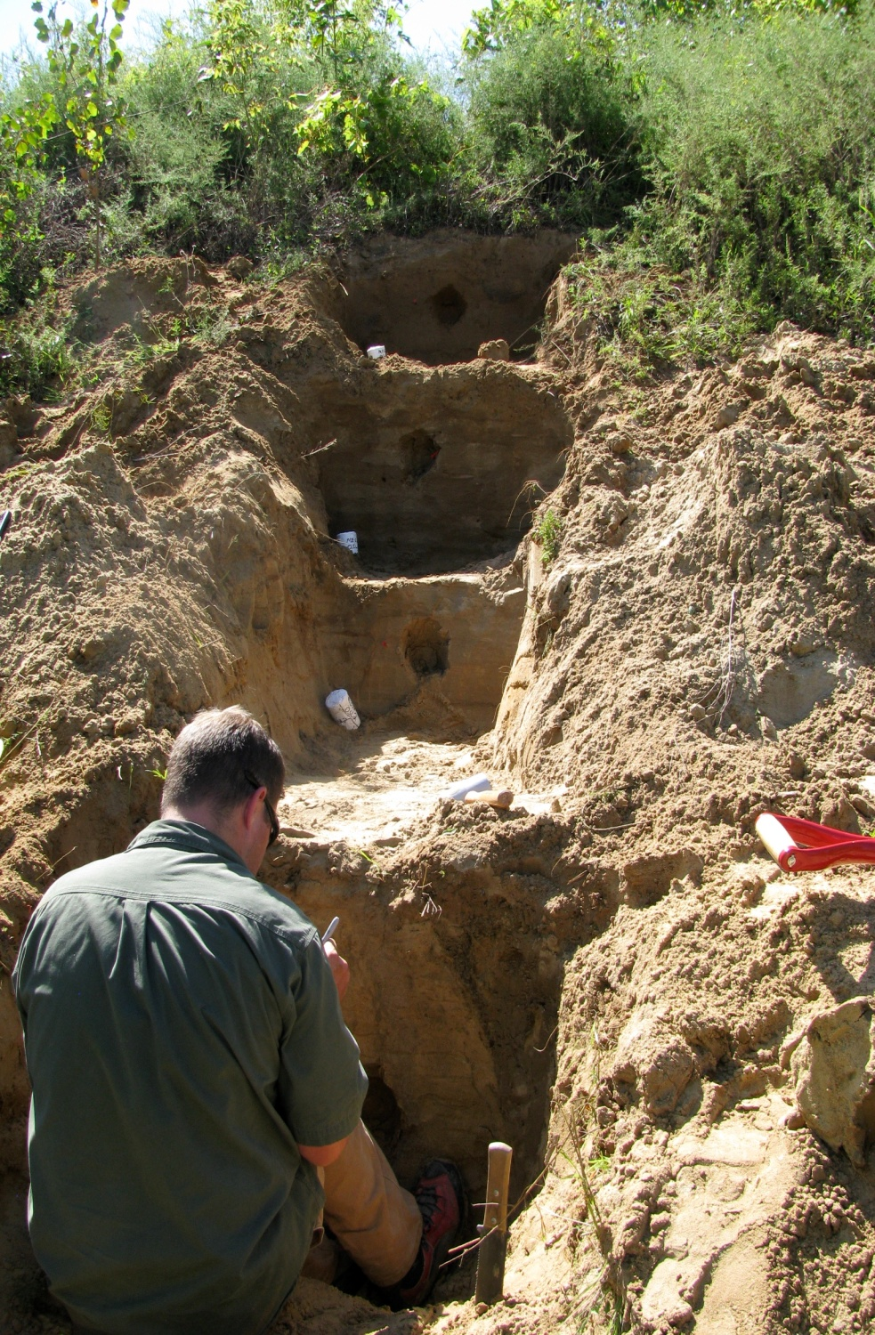
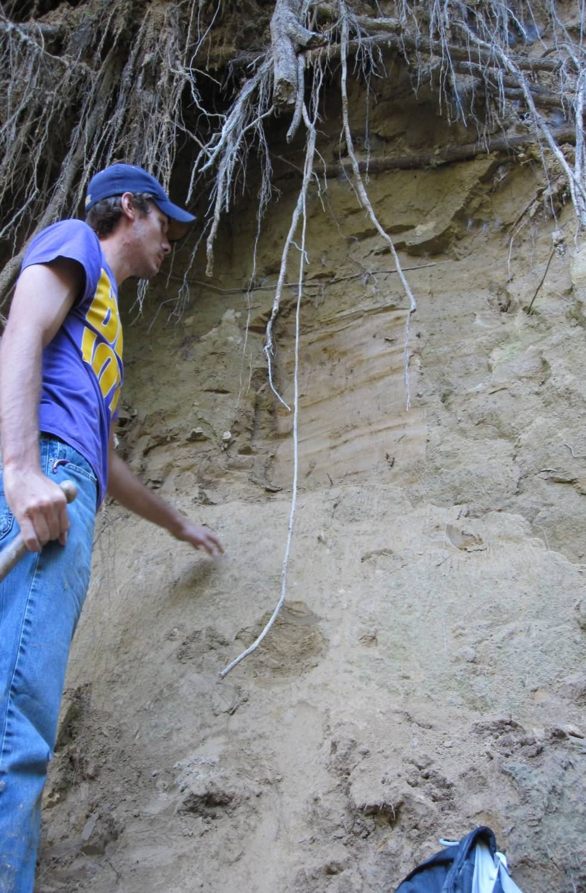
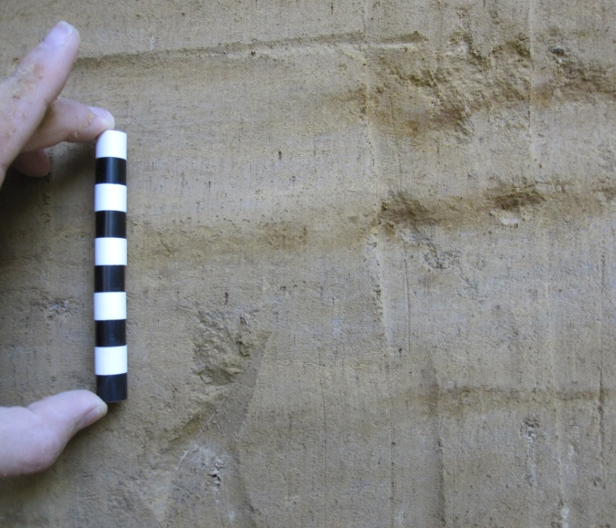
Surficial Geology of the Dunkerton Quadrangle, Black Hawk County Iowa
Chad Heinzel, Jordan Vastine, and Nicholas Bosshart, Department of Earth Science, University of Northern Iowa
INTRODUCTION
This mapping project represents a collaborative effort between the University of Northern Iowa, the Iowa Geologic and Water Survey, and the United States Geological Survey (EDMAP). The mapping boundaries are 92° 15' to 92° 07' 30” W longitude and 42° 45' to 42° 37' 30” N latitude (7.5' USGS Readlyn Quadrangle). The mapping area lies in a terrain of dissected Pre-Illinoian glacial deposits that blanket a bedrock surface with significant relief. Geologic units within the project area include Devonian carbonate bedrock; Pre-Illinoian till and alluvium; Wisconsin outwash, loess, and Holocene alluvium, colluvium, and eolian sand. This geologic effort will provide a foundation to facilitate the production of specific environmental land-use planning tools, e.g. groundwater vulnerability maps, for Bremer and Black Hawk Counties and local family farms. These geologic data are being used to construct or improve rural water resource management plans, wetland protection programs, identify aggregate, limestone/dolostone, and the delineate pollution potential from Iowa's growing confined animal farming operations (CAFOs).
METHODS
-Use of classic and modern field mapping techniques.
Collect soil samples by completing multiple shallow transects using a bucket-auger.
Cores 30 ft or greater obtained for a comprehensive suite of sediments.
Make use of existing geologic data (water well logs, shallow landscape/sediment packing drilling), deeper (bedrock) drilling, digital elevation models, field mapping, data from soil surveys, and morphological characteristics viewed on aerial images to delineate surficial geology mapping units within the Waverly Quadrangle.
Collect data using Trimble GeoXH units to facilitate the collection of an accurate Geographic Information System database and accompanying metadata.
-Optically Stimulated Luminescence (OSL) Dating samples were obtained and are being analyized.
Iowan Surface
Bedrock Map, Waterloo fire!
Anderson and Witzke, 2010
ACKNOWLEDGEMENTS
We thank the United States Geological Survey and the EDMAP program for financially supporting the mapping project. We acknowledge the support of the Iowa Geologic Survey including Deb Quade, Steph Surine, Robert McKay, Paul Liu, and Ray Anderson. We greatly appreciate the University of Northern Iowa’s dedication to fostering and engaging students in research. We also thank the town of Waverly and the surrounding landowners of Waverly for their interests in geology and permission to learn from their land.

